Slide 1
Sales Dashboard
File created on: 26-Jul-22 11:45:54 AM

Slide 2
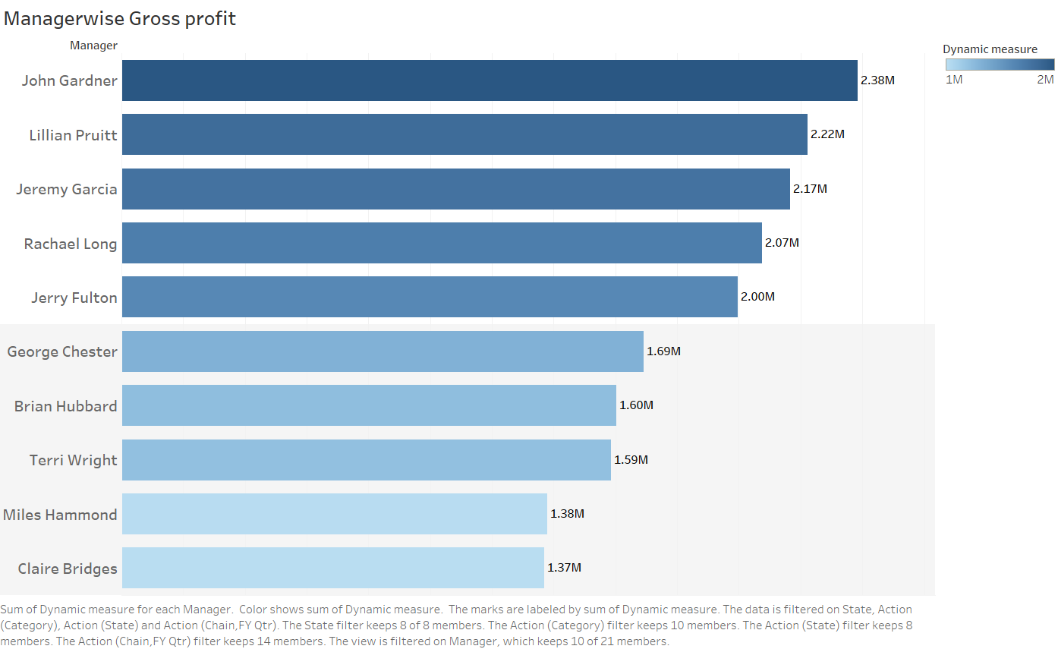

Slide 3
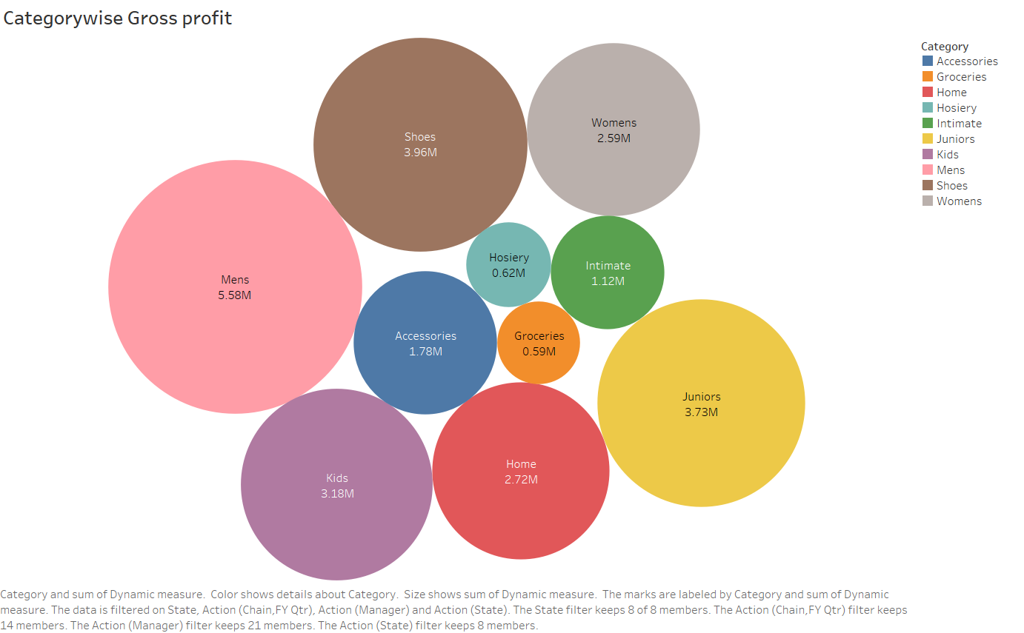

Slide 4
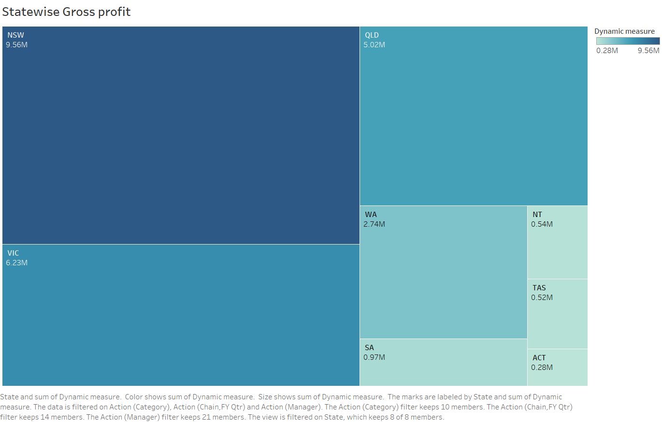

Slide 5
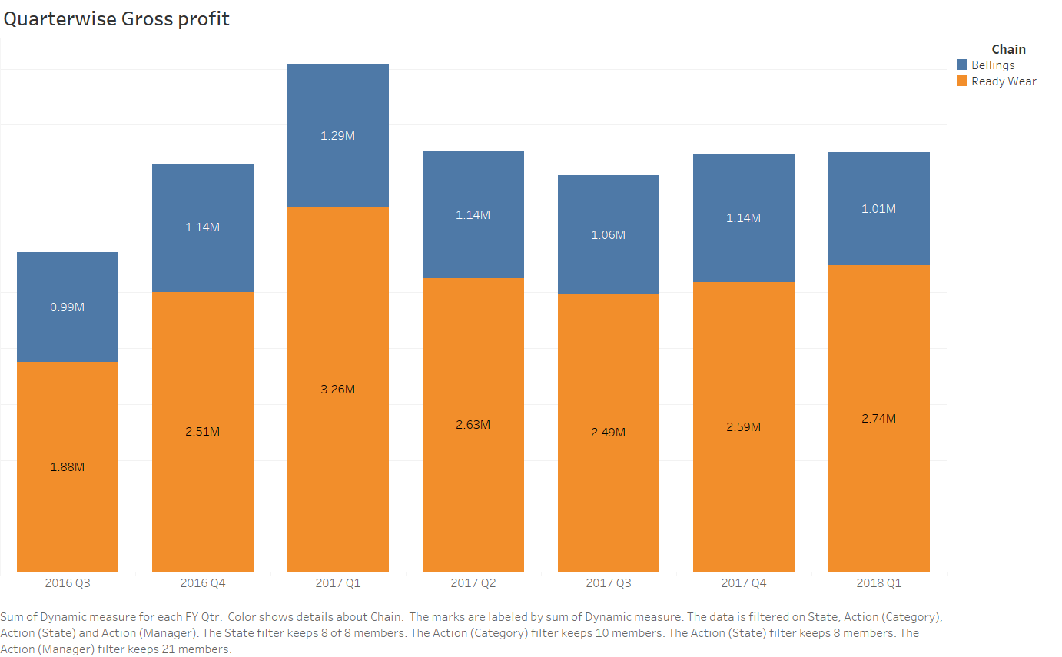

Slide 6
